Slide 1

Vitality
172122Z Benjamin Loke
172001L Lee Shang Ji
170427J Shaqueel
170456C Koo Jia Rong
172808H Tan Yong Rui

Slide 2
Overview of Content
Survey Results
Empathy Map
User Stories
Page Functions

Slide 3
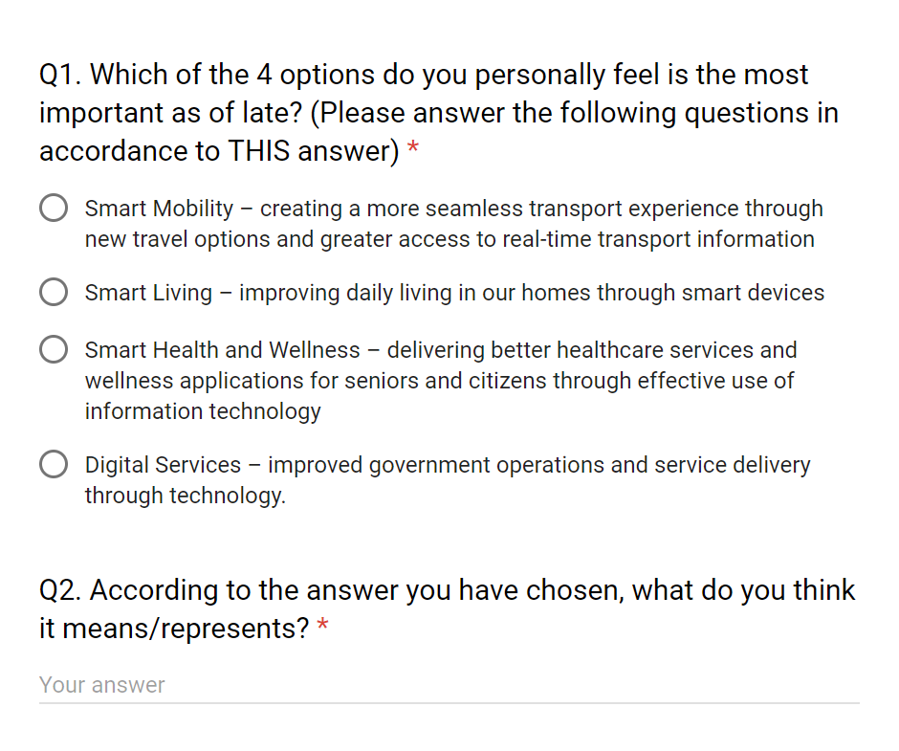
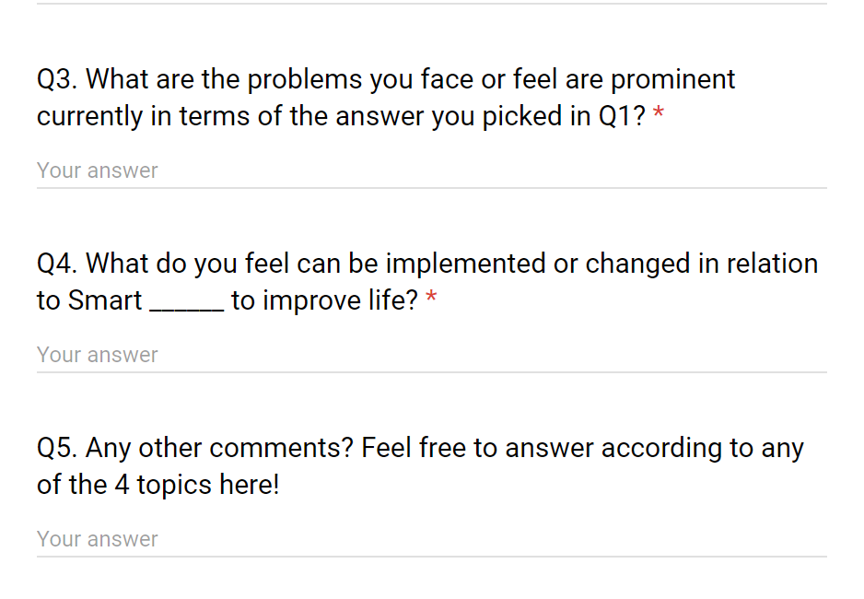
Survey Questions

Slide 4
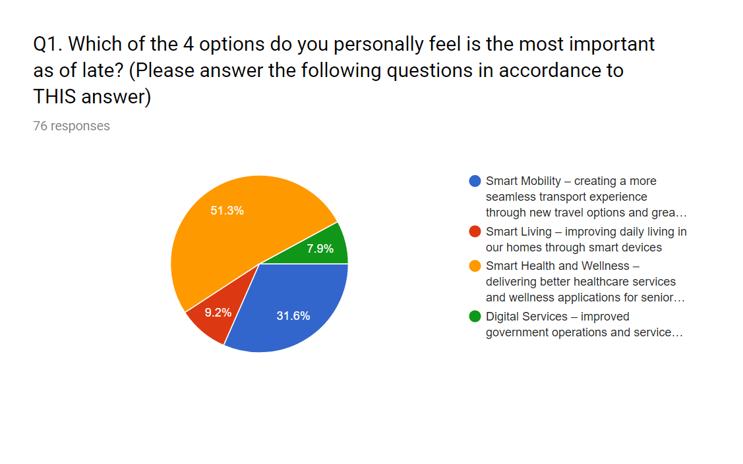
Survey Results

Slide 5
Say
Utilise technology for the benefit of society
The technological changes will change lifestyle
Overwhelming for people
Keep the new technology user-friendly
Some diseases do not have a cure
Keep technology easy to use for elderly.
More transparencies for doctors, clinics etc.
Self diagnosis, video conferencing instead of clinic visits
Think
Technology needs to cater to the elderly better, healthcare-wise
Doctors should be less “behind the scenes”, and be more upfront about anything
Want healthcare to be more convenient.
Want more engineers to find cures
Do
Doesn’t use hand gestures a lot.
Furrows eyebrows and seems to be thinking a lot
Smiles occasionally
Feel
Feels technology may be too tough for us
Feels embracing toward technology even though he thinks it’ll be tough
Feels that the technology can be used to make clinical visits more convenient?

Slide 6
User Stories
https://waffle.io/leeshangji/OOPP-Project

Slide 7
Demonstration
Of
Page Functions

